Slide 1
INT247 Machine Learning Foundations
Class Exercise #7
Decision Tree and Random Forest Classifers

Slide 2
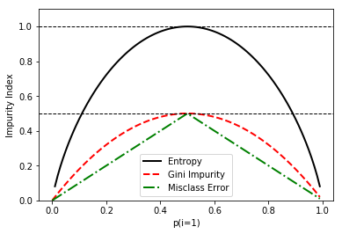

Exercise#1
Write a program to plot gini index, entropy and misclassification error metrices of decision tree.
Input :
X: numpy array from 0 to 1, step size 0.01
Output:
Define a function for gini, entropy and misclassification error.
Plot using matplotlib
Expected result as

Slide 3
Exercise#2-Decion Tree Classifier
Input :
Data: Load iris data sets from CSV
X: consider two features data for inputs.
Y: consider corresponding targets
Output:
Divide the data in train 70% and test 30% randomly.
Train Decision tree and predict
Accuracy
Number of misclassified samples

Slide 4
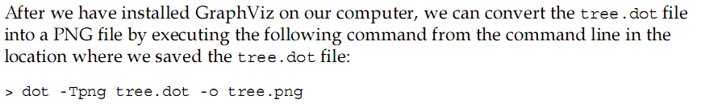
Decision Tree Visulization
from sklearn.tree import export_graphviz export_graphviz(tree,
out_file='tree.dot',
feature_names=['petal length', 'petal width'])

Slide 5
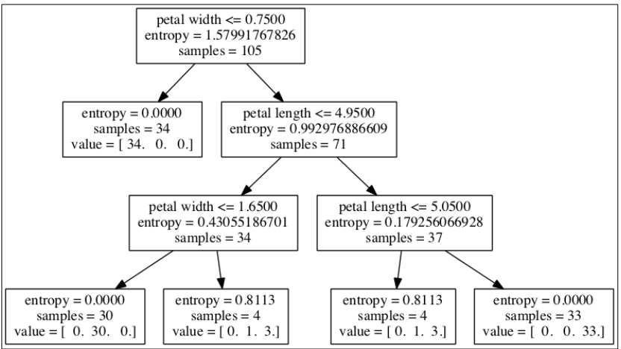
Expected outcome

Slide 6
Home assignment#1
Comment on accuracy on different train& Test Size randomly.
Comment on accuracy on different Criterion Function and maximum deapth.

Slide 7
Exercise#3-Random Forest Classifier
Input :
Data: Load iris data sets from CSV
X: consider two features data for inputs.
Y: consider corresponding targets
Output:
Divide the data in train 70% and test 30% randomly.
Train random forest classifier and predict
Accuracy
Number of misclassified samples

Slide 8
Home assignment#2
Comment on accuracy on different train& Test Size randomly.
Comment on accuracy on different Criterion Function and number of estimators.

Slide 9
Thank You !!!

